Slide 1
Head Loss in storm water systems Check valves
Webinar
Notes:
Head loss
Gravity systems vs. Pump

Slide 2
$$h_{L}=\left(\frac{fL}{D}+\sum{K_{L}}\right)\left(\frac{V^{2}}{2g}\right)$$ $${Δp_{f,minor}}_{L}=\frac{K_{L}ρV^{2}}{2}=ρgh_{L,minor}⟹h_{l,minor} =K_{L}\frac{V^{2}}{2g}$$ | f : Friction factor [-] L: Length [m] D: Diameter [m] V: Velocity [m/s] K_{L}: Loss coefficient [-] g: Gravity [m/s²]
Notes:
Head loss is divided into two subcategories. Major and minor losses
Factors affecting the Head Loss for a pipe
K – factor

Slide 3
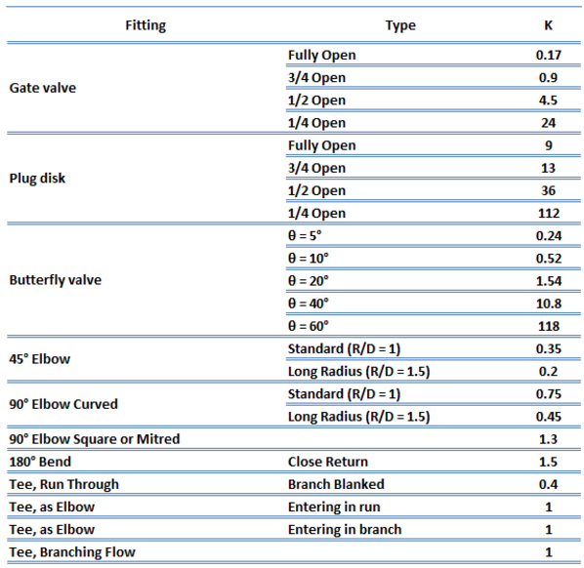

Slide 4
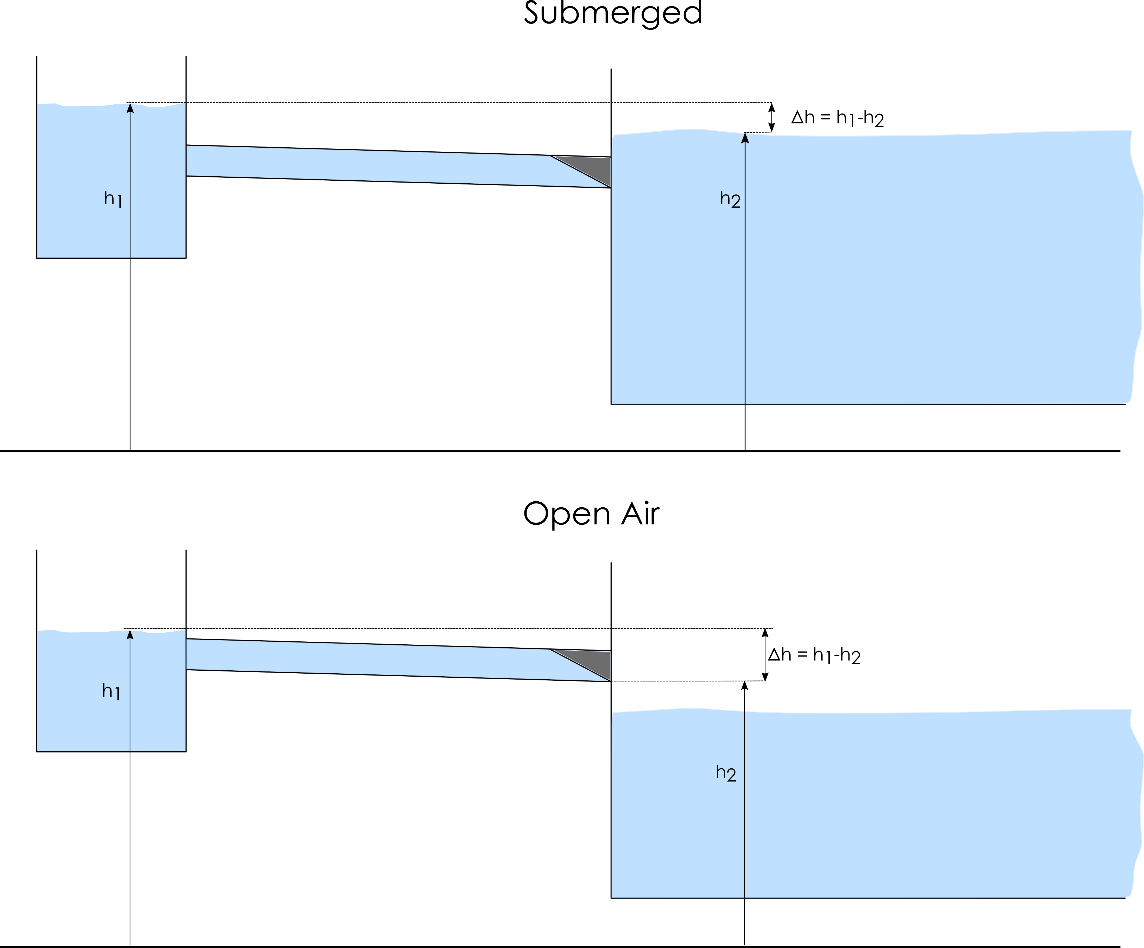
Notes:
Reference points, opening pressure.

Slide 5
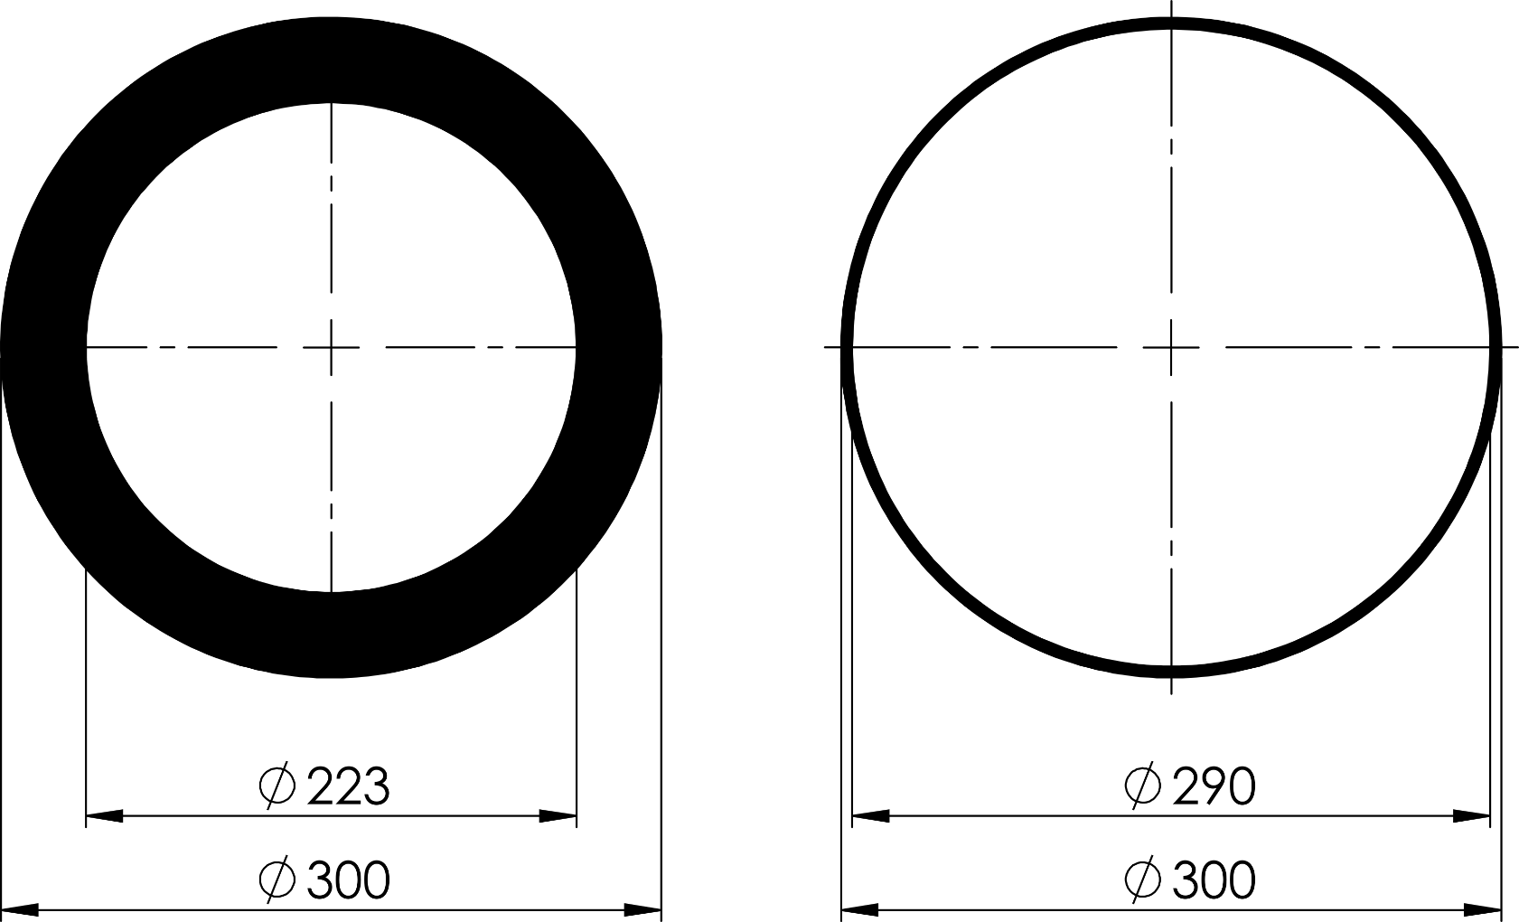
Notes:
Guess which one has the highest head loss

Slide 6
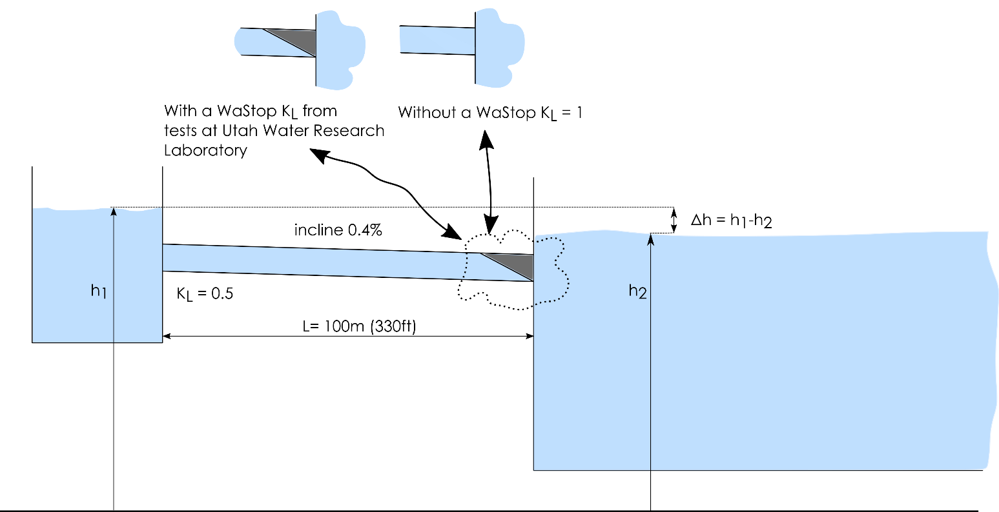
Assumptions
Concrete DN600 /NPS 24’’ pipe
Sharp inlet K_{L} = 0.5
Outlet without WaStop K_{L} = 1
L=100m /330 ft.
Notes:
Case

Slide 7
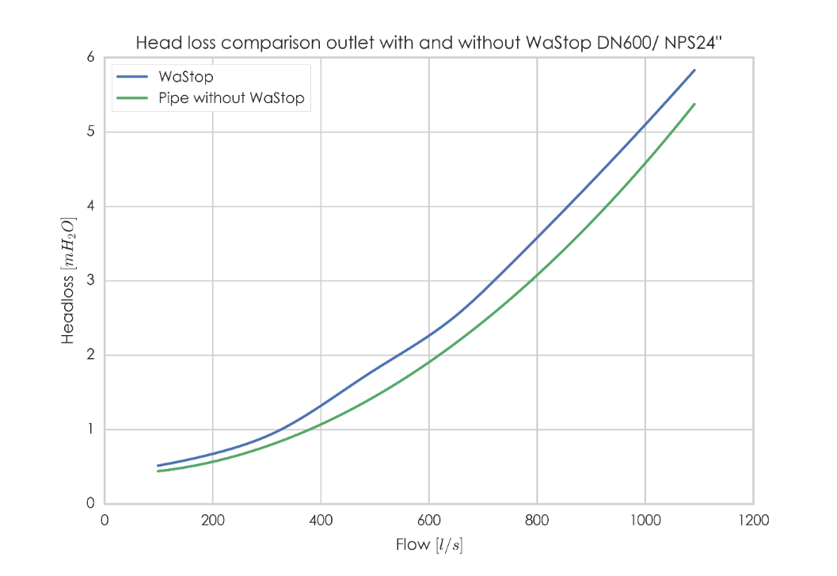
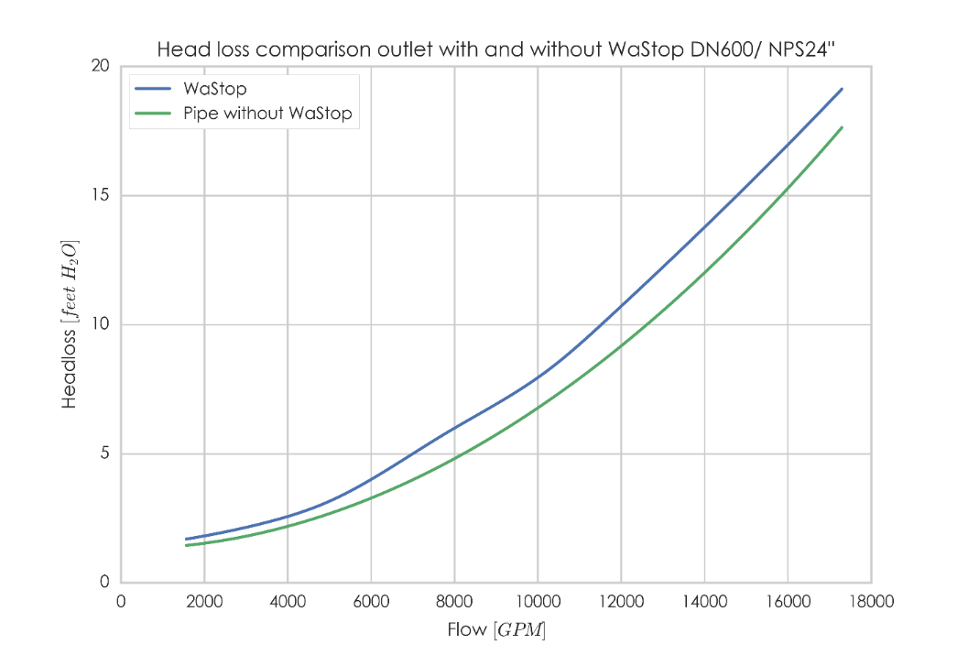
Notes:
Difference is the additional head loss

Slide 8
Notes:
A video of a 60’’ valve being tested, we wanted to go higher flow but was starting to empty the lake upstream .

Slide 9
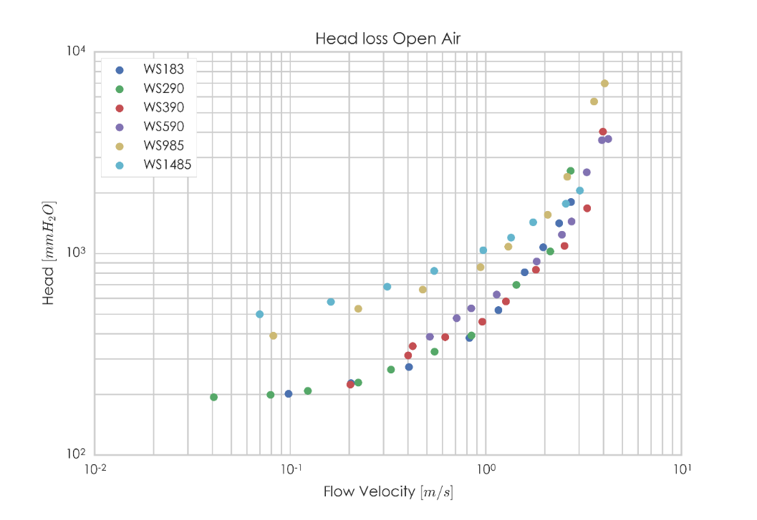
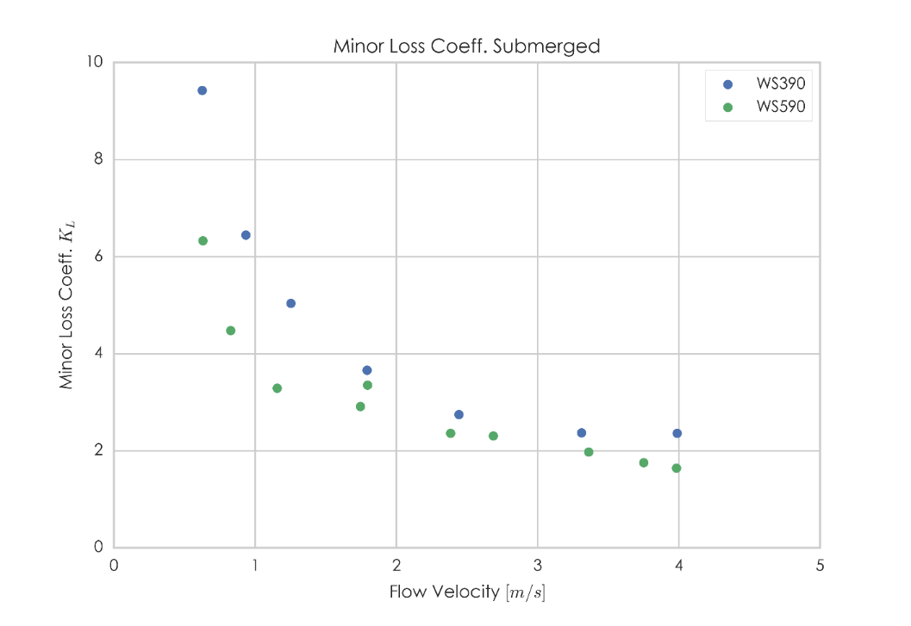
Notes:
Results utah tests.
Head loss outlet without wastop kl=1

Slide 10
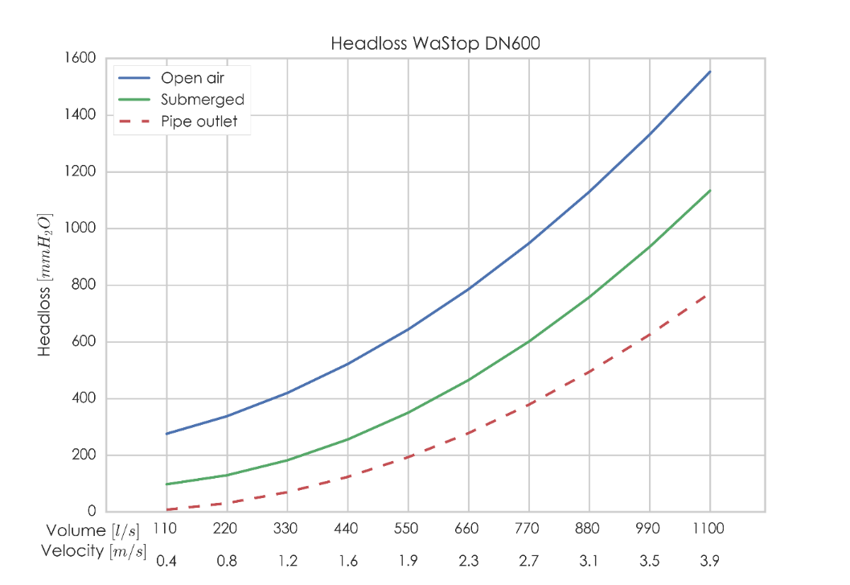
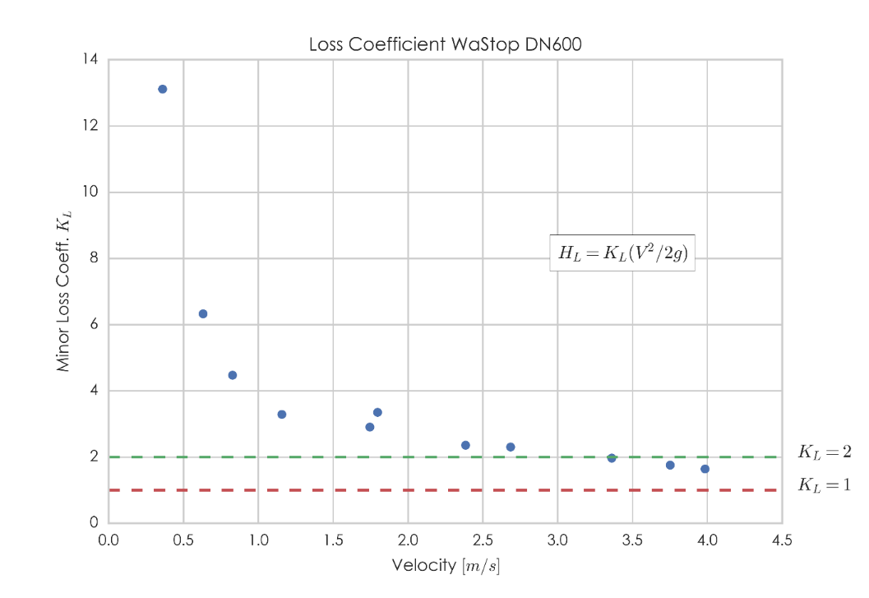

Slide 11
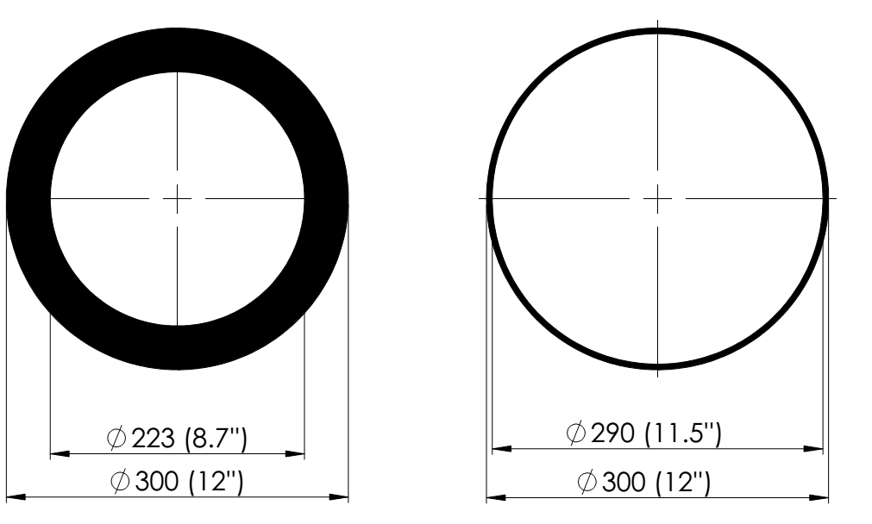

Slide 12
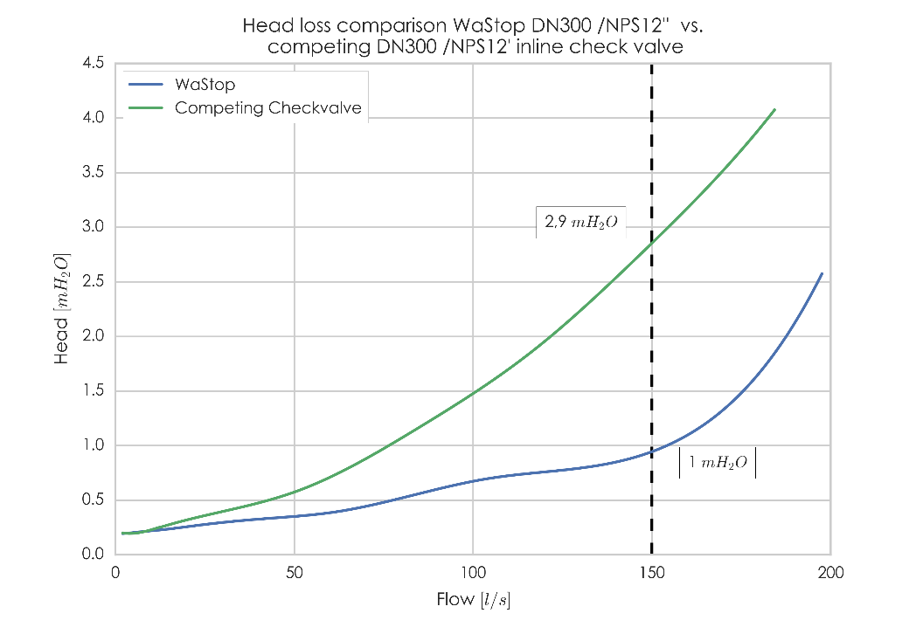
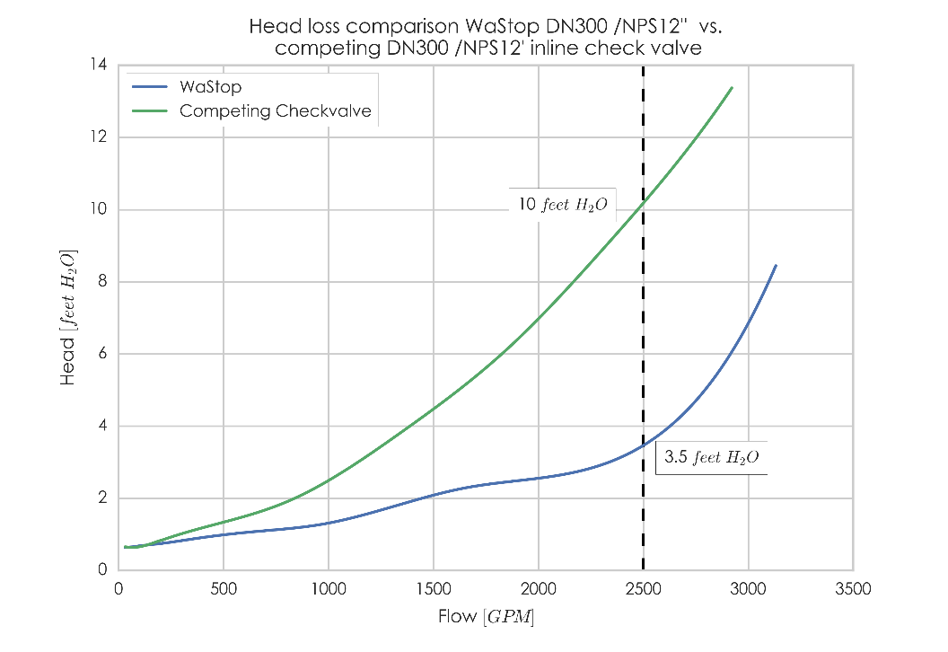

Slide 13
Comparing Test Data
“Tests were run with the flap disc removed from the valve and then with the flap disc in place. The difference in the head loss was therefore the result of the disc.”
Notes:
http://www.penntroy.com/valve-products/troy-valve/flap-valves/standard-flap-valves/page.aspx?id=1349

Slide 14
High head loss in gravity driven systems = high surface elevation upstream.
Be aware when comparing head loss data if the test procedure is not presented, since it is easy to alter reference points and the procedure to make head loss appear low.

Slide 15
www.wapro.com

